Slide 1
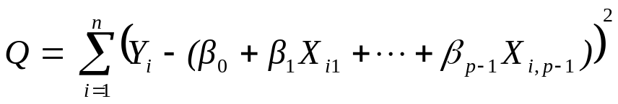
Multiple Regression
Recall our model for multiple regression is
And assuming that E{ε_{i}} = 0, the regression function is
E{Y} = β₀ + β₁X₁ + β₂X₂ + ….+ β_{p-1}X_{p-1}.
To fit the model, we use the least squares method. The LS estimates b₀, b₁, …, b_{p-1} of the unknown parameters β₀, β₁, … β_{p-1} are the values of β₀, β₁, … β_{p-1} which minimize Q where

Slide 2
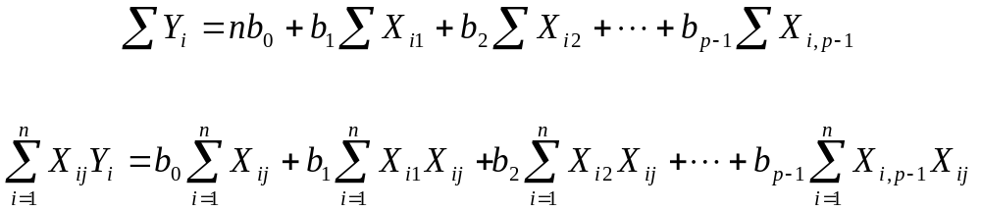
Multiple Regression
The least squares estimates can be found by setting the partial derivatives of Q with respect to β₀, β₁, … β_{p-1} to zero and solving the resulting equations.
Taking the partial derivatives and setting them to 0 gives us the normal equations

Slide 3


Multiple Regression
These are p simultaneous equations with p unknowns that can be solved on a computer or otherwise to obtain the least squares estimates b₀, b₁, …, b_{p-1}.
To asses the goodness of fit of the model, we use the residuals defined by
where

Slide 4

Multiple Regression
For an overall measure of the goodness of fit, we can use the error sum of squares SSE as defined earlier.
We compare this SSE to the total sums of squares SSTO
The reason for using SSTO as a benchmark of comparison is the same as in the case of simple linear regression.

Slide 5
Multiple Regression
Recall that the SSTO measures the variation in the observations when the predictor variables are not taken into account.
The SSR measures the variation in the observations explained by the model, that is by all the X variables.
A natural measure of the effect of the predictor variables in reducing the variation in Y is to express the explained variation as a proportion of total variation.

Slide 6
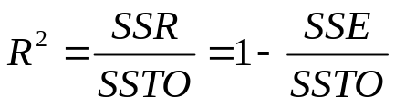
Multiple Regression
For multiple regression, the measure R² is called the coefficient of multiple determination and we have
R² is the ratio of the variation explained by the model to the total variation.
We can interpret R² as the proportion of the total variation that is accounted for by the use of all the predictor variables. That is, the proportion of variation explained by the model.
R² ranges from 0 to 1 and note adding more predictor variables to the regression model can only increase R² and never reduce it.

Slide 7
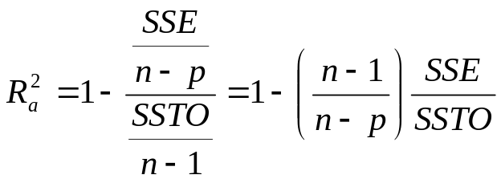
Multiple Regression
Since R² usually can be made larger by including a larger number of predictor variables, it is sometimes suggested to balance the concept of a better fit with the number of predictor variables.
A modified measure can be used that adjusts for the number of predictor variables in the model.
The adjusted coefficient of multiple determination, denoted by R_{a}², adjusts R² by dividing each sums of squares by its associated degrees of freedom.

Slide 8
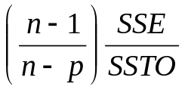
Multiple Regression
The adjusted coefficient of multiple determination may actually become smaller when another X variable is introduced into the model.
When a predictor variable is added to the model, p gets larger, thus the n-p term becomes smaller and the term
becomes larger, which reduces the value of R_{a}² which is 1 minus this term.
If this increase is not offset by the decrease in the SSE by adding the X variable, then R_{a}² will become smaller. Thus, only adding X variables that cause a decent increase in the fit of the model will cause an increase in R_{a}².

Slide 9
Multiple Regression
A hypothesis often tested as a first step in fitting a multiple regression model is
H_{o}: β₁ = β₂ = … = β_{p-1} = 0 vs H_{a}: At least one β_{k} ≠ 0
Here the null hypothesis states that none of the predictor variables are linearly related to Y since all the regression coefficients are 0.
The alternative hypothesis states that at least one of the predictor variables is linearly related to Y.
When the null is true, the statistic F* = MSR/MSE follows an F distribution with p-1 and n-p degrees of freedom.

Slide 10
Multiple Regression
Therefore the decision rule for an α level test is
If F* ≤ F(1- α, p-1, n-p), fail to reject Ho
If F* > F(1- α, p-1, n-p), reject Ho
A statistically significant F statistic does not pinpoint which β_{k} are nonzero.
T-tests for the individual β_{k} are used to answer this question.
The identity SSTO = SSR + SSE derived for simple regression holds for multiple regression.

Slide 11
Multiple Regression
The degrees of freedom associated with SSR are p-1, corresponding to the number of predictor variables in the model.
The degrees of freedom associated with SSE are n-p, which corresponds to the difference between the sample size and the number of unknown parameters.
This F test, testing if any of the predictors has an effect on the mean response, is called the overall F test.
SAS (mulitple_inference)

Slide 12

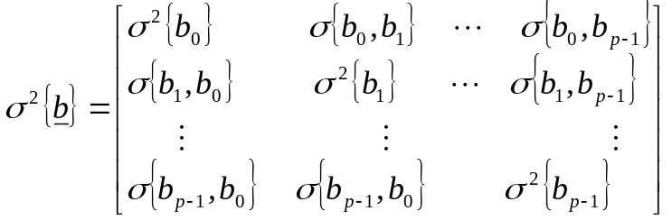
Multiple Regression
The least squares estimators b are unbiased:
The variance-covariance matrix σ²{b}
is given by σ²{b} = σ²(X’X)⁻¹
The estimated variance-covariance matrix s²{b} contains the estimated variances and covariances such as s²{b₁} and s{b₀} and we have that s²{b} = MSE(X’X)⁻¹

Slide 13
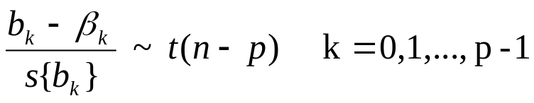

Multiple Regression
From s²{b} one can obtain s²{b₀}, s²{b₁}, or whatever other estimated variance or covariance is needed.
For the normal error regression model we have that
Hence the confidence interval for β_{k} is

Slide 14
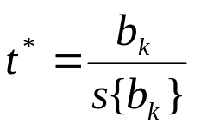
Multiple Regression
Tests for β_{k} are set up the usual way
H_{o}: β_{k} = 0 vs H_{a}: β_{k} ≠ 0.
And we use the test statistic
The decision rule is,
if | t* | ≤ t(1-α/2;n-p) fail to reject Ho
if | t* | ≥ t(1-α/2;n-p) reject Ho
The power of the t test can be obtained as described before, using n-p degrees of freedom. SAS (mulitple_inference)

Slide 15

Multiple Regression
The Bonferroni joint confidence intervals can be used to estimate several regression coefficients simultaneously.
If g parameters are to be estimated jointly, the individual confidence intervals with a family confidence coefficient 1 – α are
Again, we use α’=a/g in place of α.
The Bonferroni and the Bonferroni-Holm procedures can be used for testing multiple regression coefficients simultaneously.

